Slide 1
Image-Based Situation Awareness Audit 28.2.2018
Sakari Lampola

Slide 2
Previous Audit 11.1.2018

Slide 3
Open questions:
Role of classical object tracking alrorithms?
What to do with multiple bounding boxes around one object?
Appropriate minimum confidence level?
What to do with false detections inside other objects?
What to do with false detections from the background?
How to set Kalman filter parameters for image object filtering?
Hungarian algorithm, special case for hidden objects
To do:
Close open questions
Image object status
Image object velocity estimation
Probabilistic approach for matching detected and image objects
2d -> 3d transformation
World object state estimation
Other:
Semantic segmentation
Organisations to follow: ICCV, ICRA, NIPS, IROS, arXiv
Camera motion (yaw, pitch,roll)
Grid or continuos presentation?
Class specific attributes
Object history
Previous Audit

Slide 4
Project Plan

Slide 5

Project Plan
Methodology / Preparation of research infra
Software platforms are constructed and tested
Off-the-shelf models are acquired and tested
Necessary skills on platforms are learned
Methodology / Method survey
Current state-of-art methods are studied
Methods are constructed and tested on the software platforms
Method follow-up
Screening of conference papers related to the subject
Possibly integrating new methods to the project

Slide 6
Work Done

Slide 7

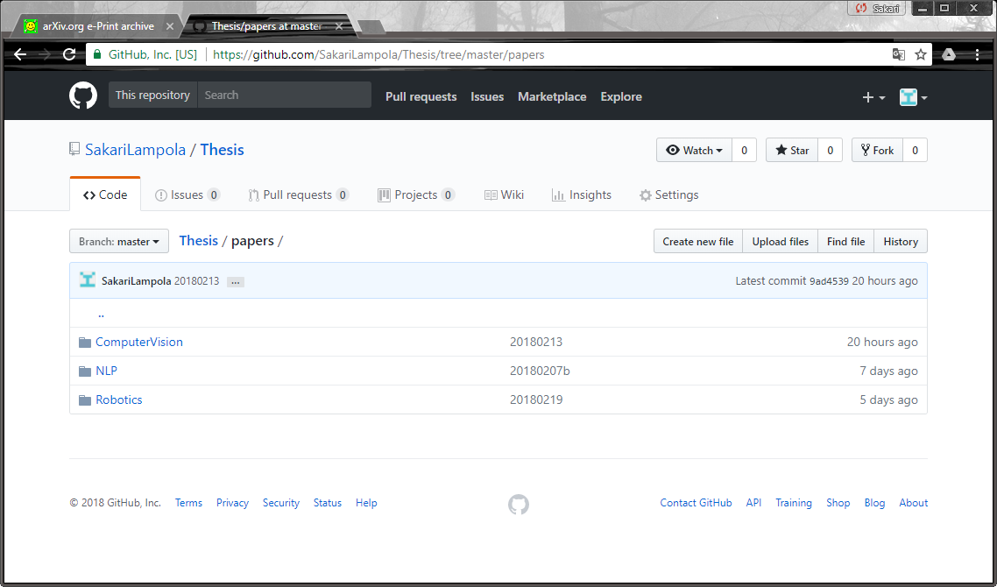
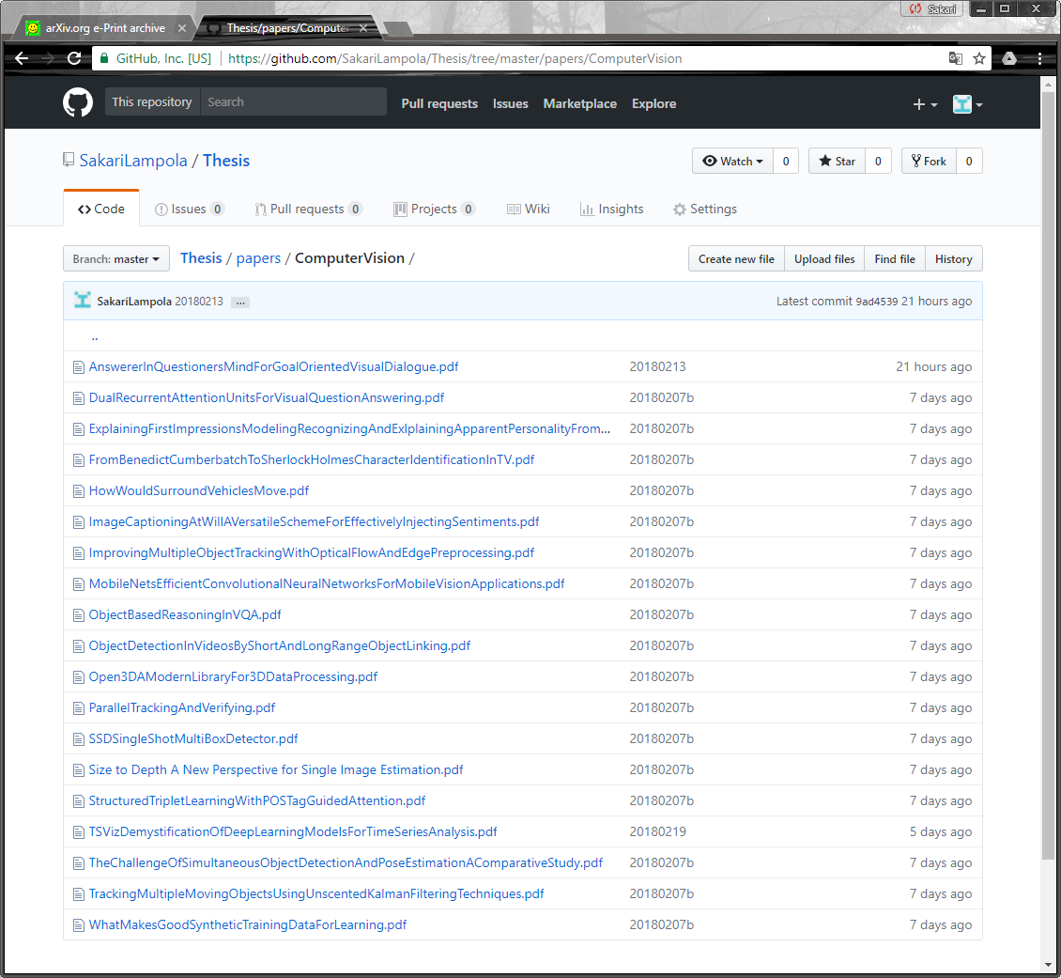
Method Follow-Up

Slide 8
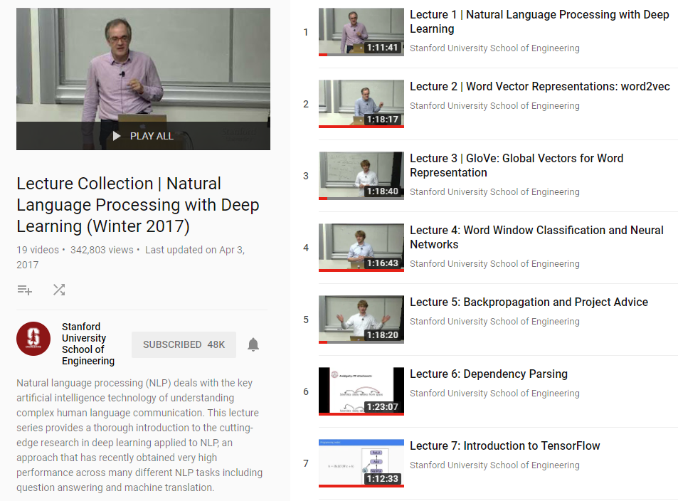
Method Survey
Christoffer Manning & Richard Socher

Slide 9
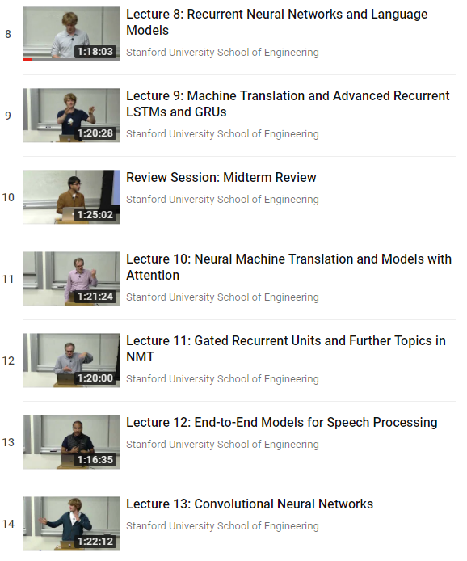
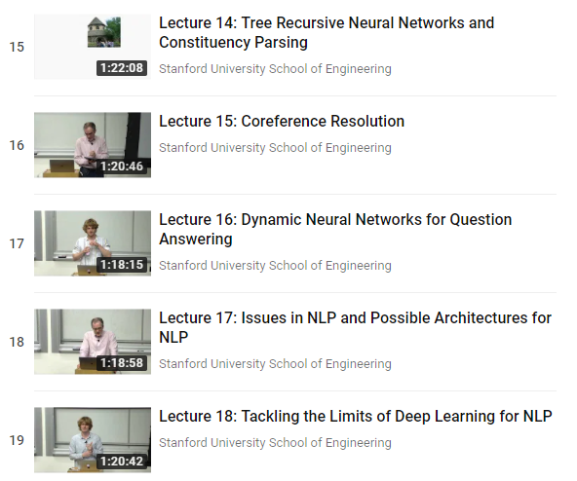
Method Survey
Goodfellow, Bengio, Courville: Deep Learning

Slide 10
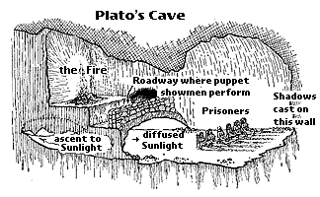
V2.0 Goal
Detected classes not hardcoded
Object class may change
Support for many cameras , rotations, movement
Names less awkward, terminology fixed
Cleaning
Python style guide followed, excluding line length
Code optimization
One package
Language (speech synthesizer)
Software Version 2.0
Name of the software package: ShadowWorld
(Plato: Allegory of the Cave)

Slide 11
Class Diagram
Software Version 2.0
PresentationForecast
PresentationMap
PresentationLog
…
Presentation
Speech
Synthesizer
World
Camera
”World object”
”Image object”
”Detected object”
Event
Body
Pattern
Detection
Trace
Forecast
Bounding
Box

Slide 12
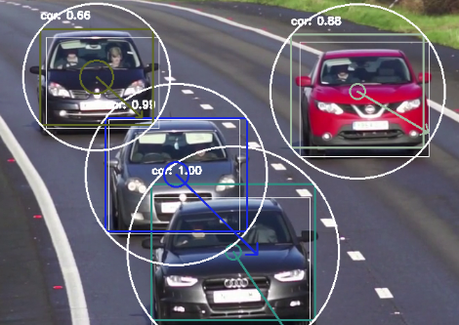
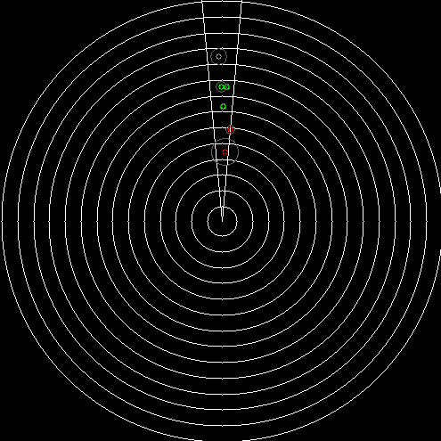
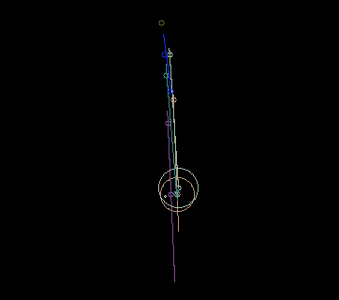
Detection
Software Version 2.0
Matching
Pattern Filtering
Distance Estimation
3D Projection
Body Filtering
Body Prediction
Collision Detection

Slide 13
Language
Software Version 2.0
pyttsx3
Speech
Synthesizer
World
Event
Event
time
priority
text
(object)
Speech synthesizer based on pyttsx3 package
Event is spelled out if priority <= 0
Event will pause video for the duration of speech (to be changed later by using separate thread)
Example events:
Body observed (1 sec after created)
Collision warning
Speech recognition later

Slide 14
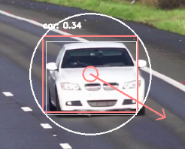
Visual Presentation (pattern)
Software Version 2.0
class
confidence
bounding box
bounding circle
center point velocity (pixels/sec)
center point
detection
center point confidence (ellipse, axes=2*standard deviation)

Slide 15
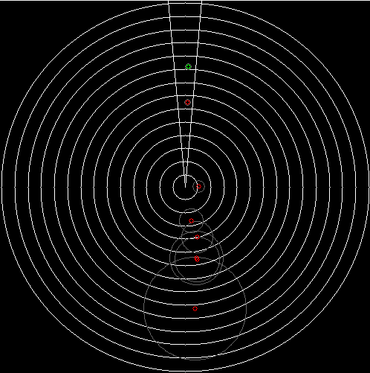
Visual Presentation (body)
field of camera view
Software Version 2.0
body (green, with reliable pattern)
body (red, with unreliable or lost pattern)
observer (+camera)
distance circles (every 10m)
location uncertainty (ellipse, axes = standard deviation)
body size (circle, radius = mean class specific radius)

Slide 16
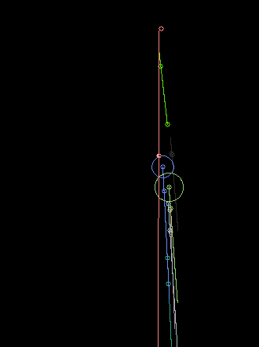
Visual Presentation (forecast)
Forecast made every FORECAST_INTERVAL (=1.0) seconds
Software Version 2.0
observer
body location, when forecast was made
body location, current
body location predicted path
body location after FORECAST_COUNT*FORECAST_DELTA seconds
collision probability > 1
body size (circle, radius = mean class specific radius)

Slide 17
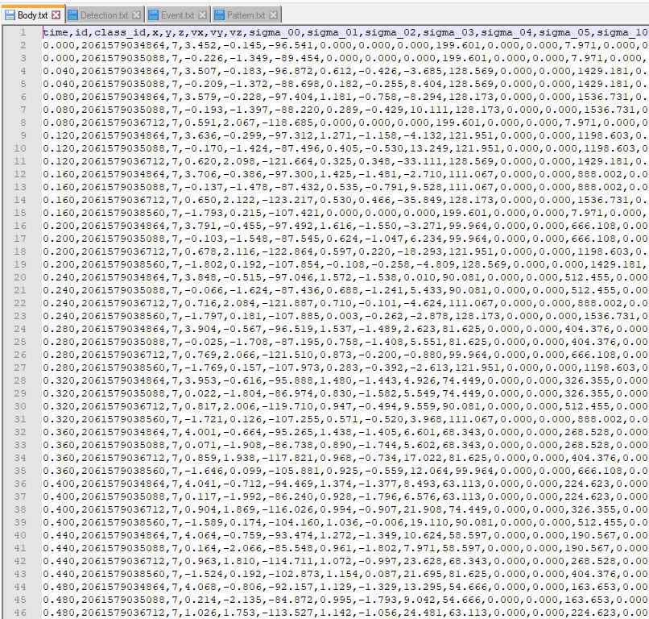
Logging
Software Version 2.0

Slide 18
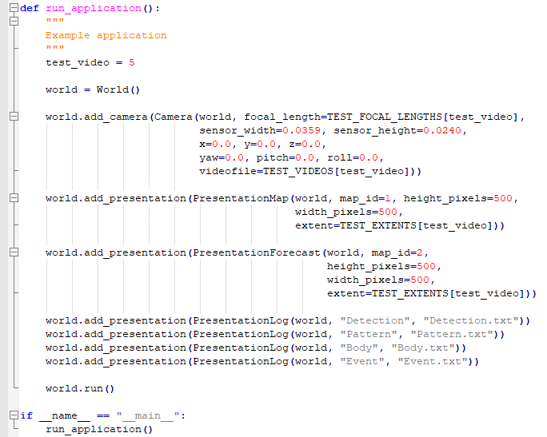
How to use?
Software Version 2.0
Demo
3-5 videos
Program code

Slide 19
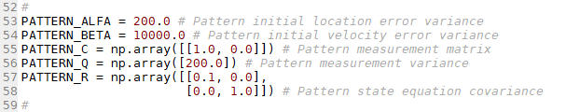
Why pattern filtering?
Reduces object detection (bounding box) noise
Provides prediction for pattern location in the next frame (matching easier)
Predicts pattern location when detection is missing
Pattern Filtering
Hyperparameters:

Slide 20
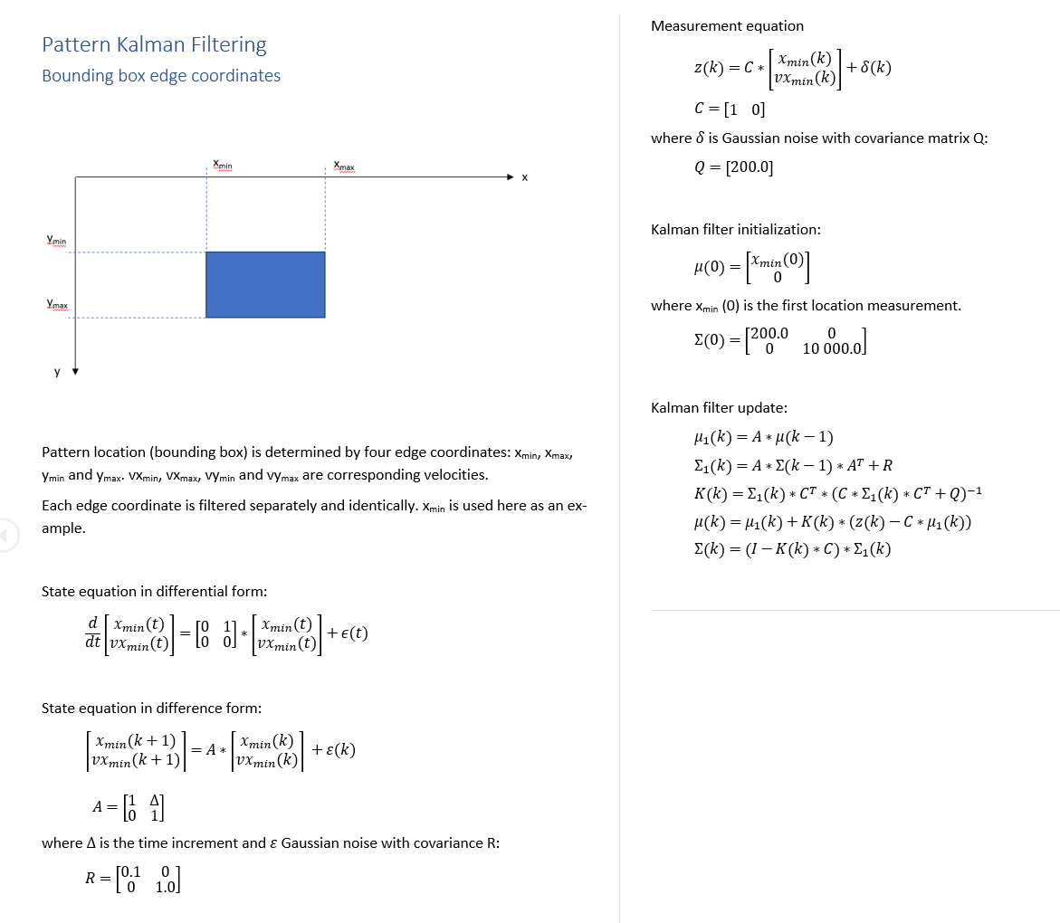
Pattern Filtering

Slide 21
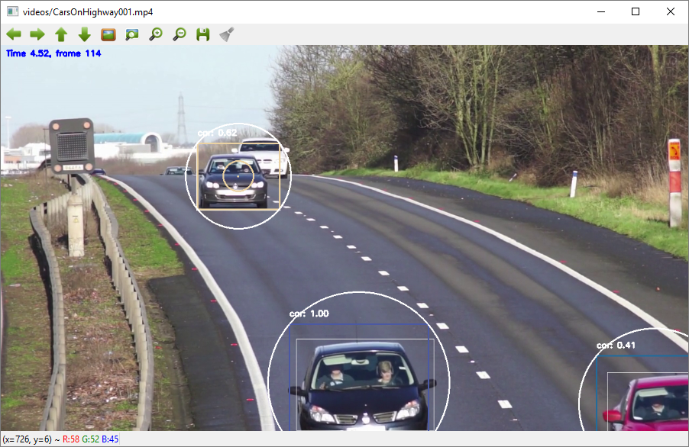
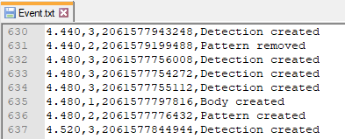
Pattern Filtering

Slide 22
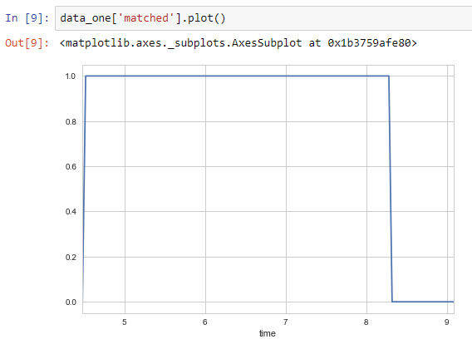
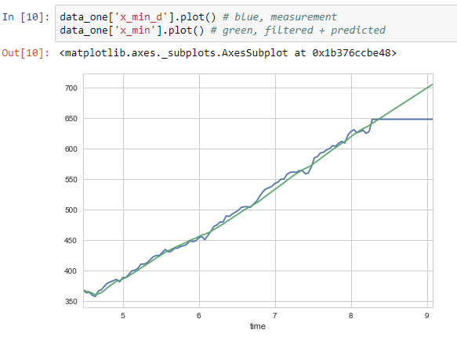
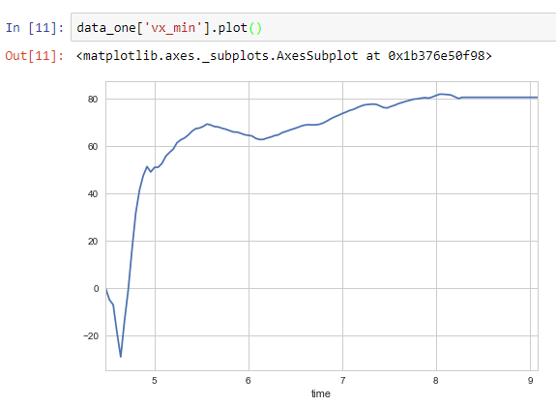
Matched status, coordinate and velocity
Pattern Filtering

Slide 23
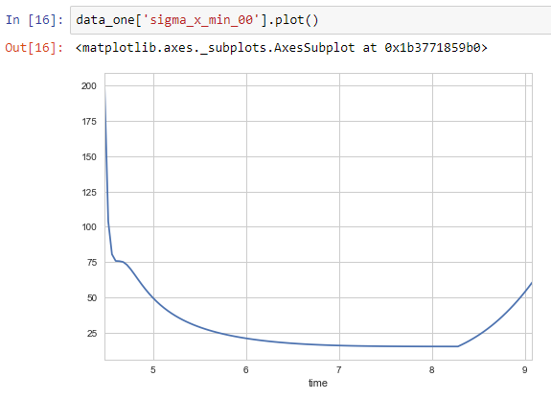
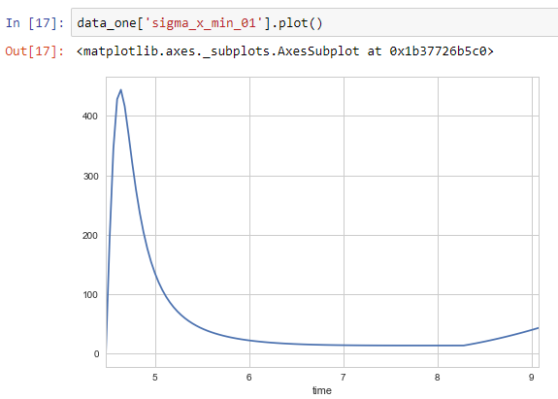
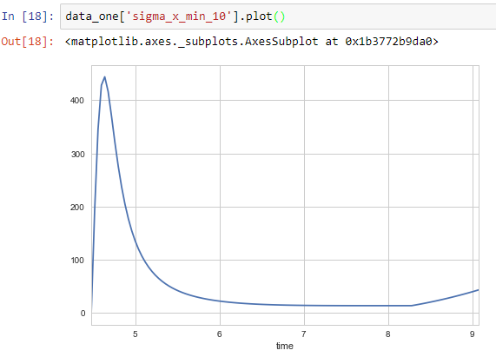
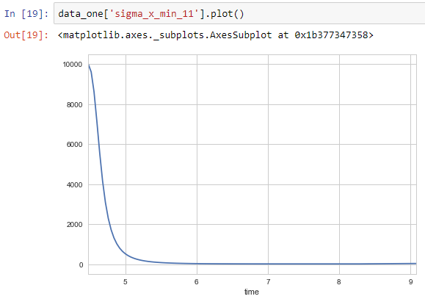
Covariance matrix
0=location, 1=velocity
Pattern Filtering

Slide 24
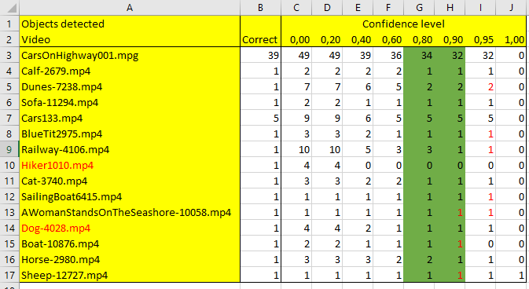
Minimum confidence level to create a pattern (and body) was varied between 0 and 1. The number of bodies created was compared to
the true number of objects in the video.
Matching / Confidence Level
Good value for creating a new pattern is between 0.8 and 0.9.

Slide 25
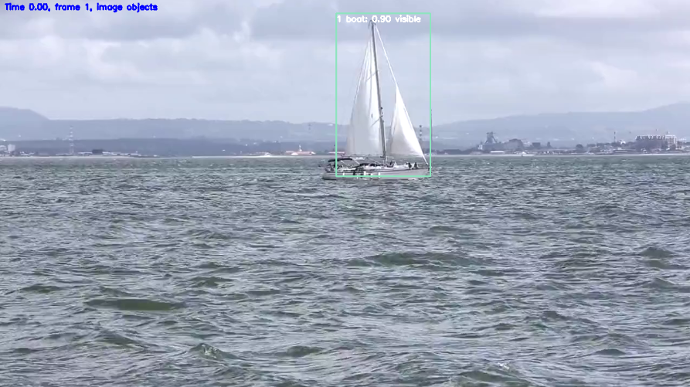
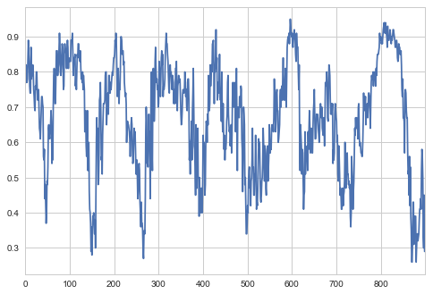
Matching / Confidence Level
Confidence level has dynamics
create
update
ignore
Different levels for creating and updating image object.
Hyperparameters:
CONFIDENCE_LEVEL_CREATE (0.8)
CONFIDENCE_LEVEL_UPDATE (0.2)

Slide 26
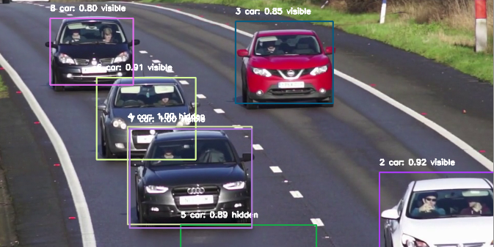
The problem: Bounding box size and form are distorded near edges
Matching / Border Behaviour
Hyperparameter BORDER_WIDTH (30)

Slide 27
Matching / Border Behaviour
1
2
3
4
5
6
Reliable
Reliable
Unreliable
Reliable, not created
Unreliable, not created
Unreliable, removed
Done for:
left
right
top
bottom
If a pattern touches 3 borders, it is removed
Reliable = body information updated

Slide 28
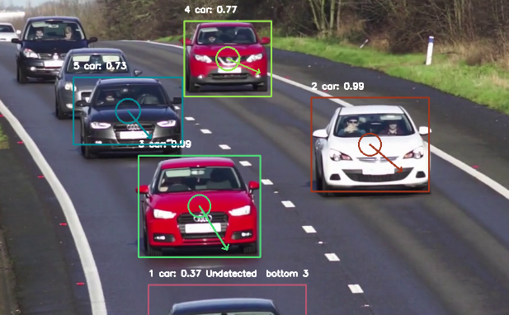
Matching / Pattern Retention
Patterns are removed if not detected in RETENTION_COUNT_MAX (30) successive frames.

Slide 29
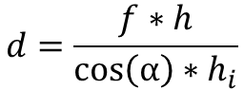
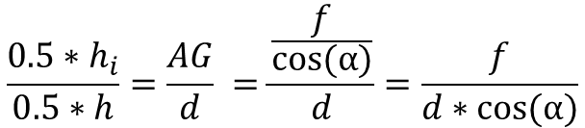
d (distance)=AF
D
Distance Estimation
F
h
E
C
G
h_{i}
α
A
B
f
Similar triangles AGE and AFD:
$$\frac{{0.5∗h}_{i}}{0.5∗h}=\frac{AG}{d} =\frac{\frac{f}{cos⁡(α)}}{d}=\frac{f}{d∗cos⁡(α)}$$
$$d=\frac{f∗h}{{\cos\left(α\right)∗h}_{i}}$$

Slide 30
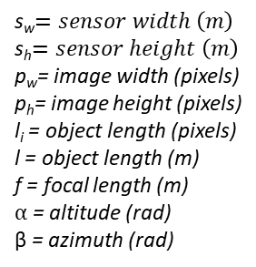
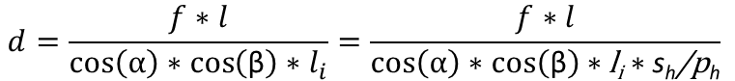
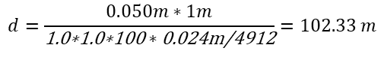
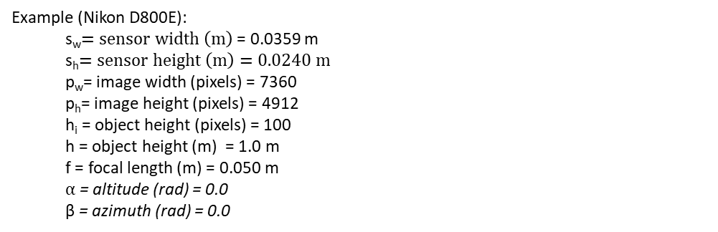
Similar equations for horizontal direction (β=azimuth):
Distance Estimation
s_{w}$=sensor width \left(m\right)$
s_{h}$=sensor height \left(m\right)$
p_{w}= image width (pixels)
p_{h}= image height (pixels)
l_{i} = object length (pixels)
l = object length (m)
f = focal length (m)
$α$ = altitude (rad)
β = azimuth (rad)
$$d=\frac{f∗l}{{\cos\left(α\right)∗\cos\left(\text{β}\right)∗l}_{i}}=\frac{f∗l}{\cos\left(α\right)∗\cos\left(\text{β}\right)∗\text{l}\text{i}∗\text{s}\text{h}\text{/}\text{p}\text{h}}$$
Assumptions:
equal vertical/horizontal pixel spacing
optical axis in image center
Example (Nikon D800E):
s_{w}$=sensor width \left(m\right)$ = 0.0359 m
s_{h}$=sensor height \left(m\right)=0.0240 m$
p_{w}= image width (pixels) = 7360
p_{h}= image height (pixels) = 4912
h_{i} = object height (pixels) = 100
h = object height (m) = 1.0 m
f = focal length (m) = 0.050 m
$α$ = altitude (rad) = 0.0
β = azimuth (rad) = 0.0
$$d=\frac{0.050m∗1m}{\text{1.0∗1.0∗100}∗\text{0.024}\text{m}\text{/4912}}=102.33 m$$

Slide 31
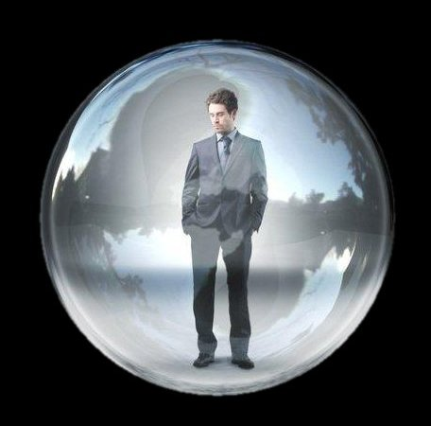
Question: How to compare pattern and body sizes for distance estimation?
Height or width alone might be misleading.
Some form of (3D) spatial simplification is needed, like
cube
rectangular prism
cylinder
sphere (probably the easiest math)
Uncertainty should be modeled.
Distance Estimation
Solution:
pattern circle <---> body sphere

Slide 32
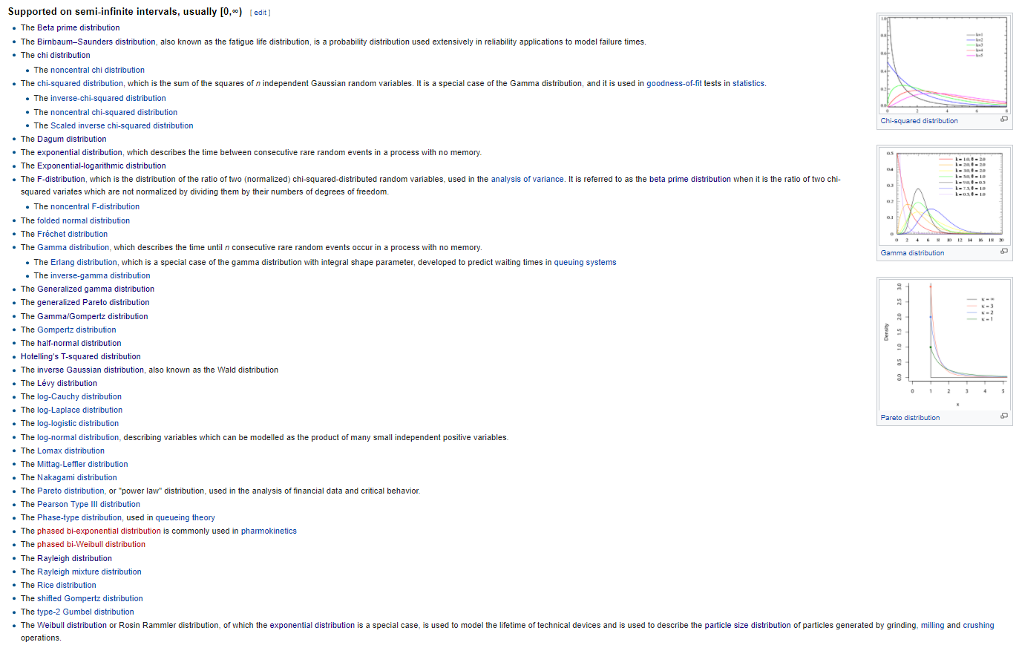
Body radius distribution
Distibution should
be defined in [0,∞]
mode > 0
simple
skew controllable
Distance Estimation

Slide 33
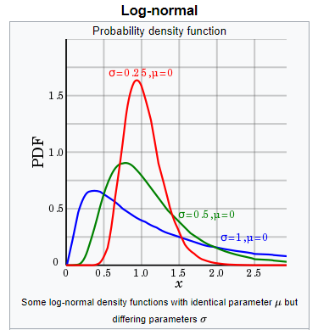
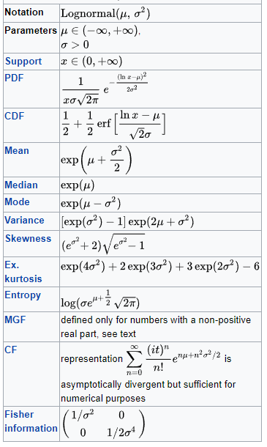
Log-normal distribution for body radius
Distance Estimation
Used in the context of describing human height distribution

Slide 34
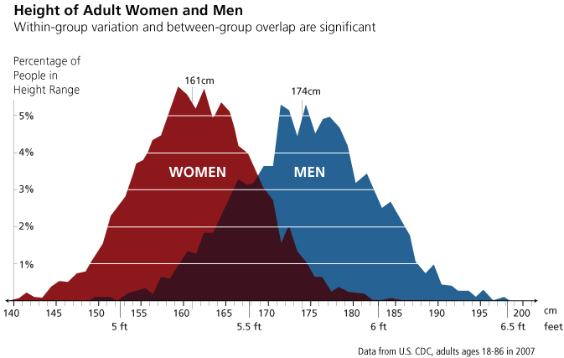
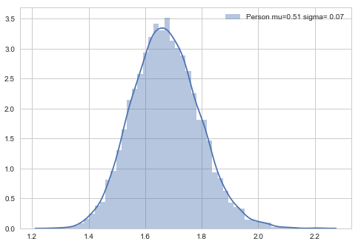
Example: Person
Distance Estimation

Slide 35
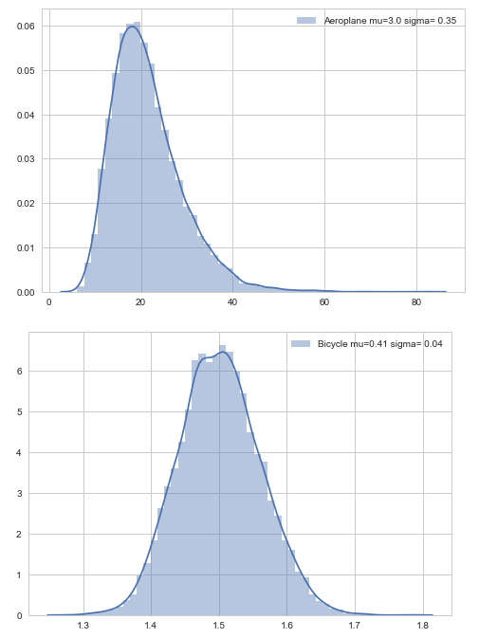
Bubble diameters (2*radius)
Distance Estimation

Slide 36
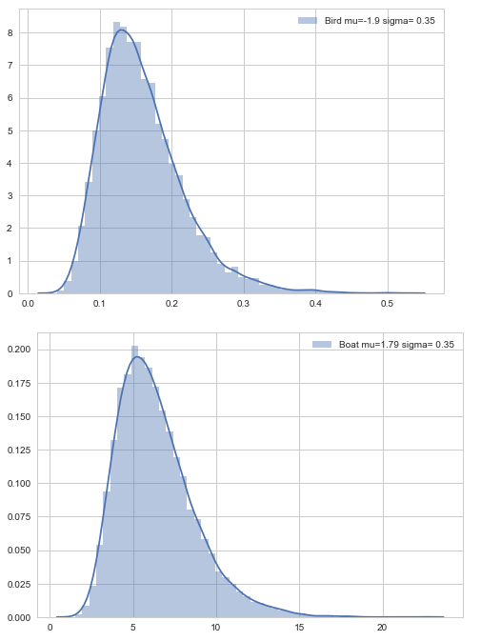
Bubble diameters (2*radius)
Distance Estimation

Slide 37
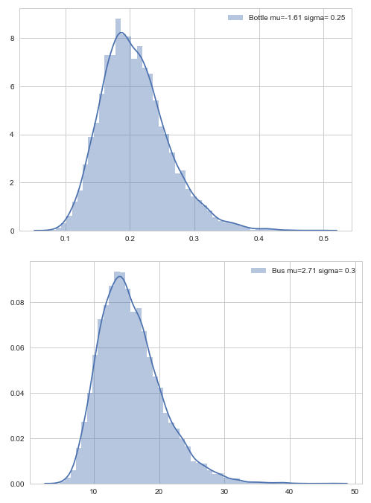
Bubble diameters (2*radius)
Distance Estimation

Slide 38
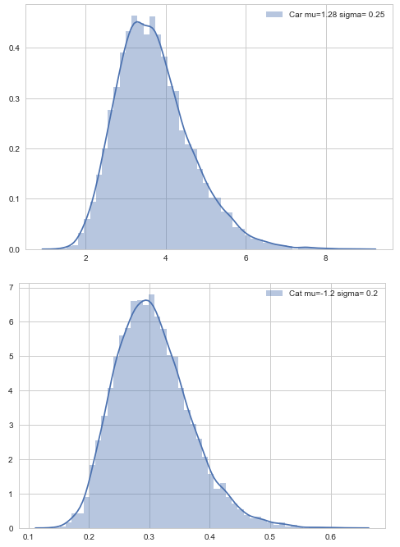
Bubble diameters (2*radius)
Distance Estimation

Slide 39
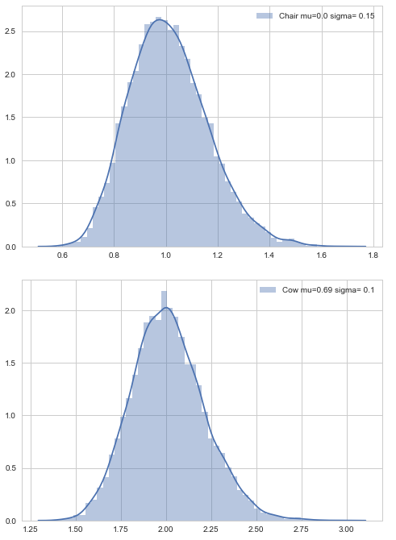
Bubble diameters (2*radius)
Distance Estimation

Slide 40
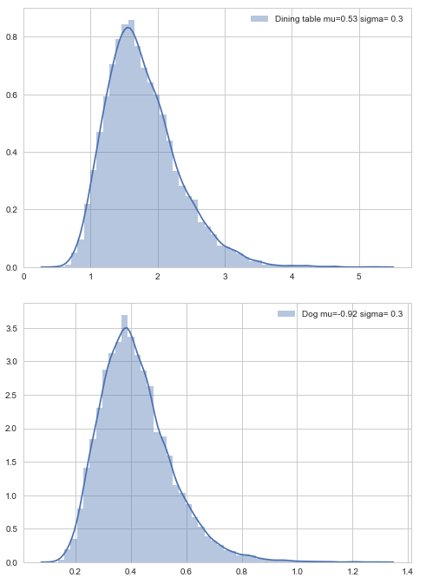
Bubble diameters (2*radius)
Distance Estimation

Slide 41
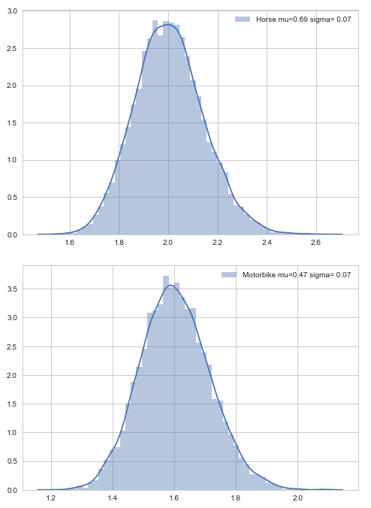
Bubble diameters (2*radius)
Distance Estimation

Slide 42
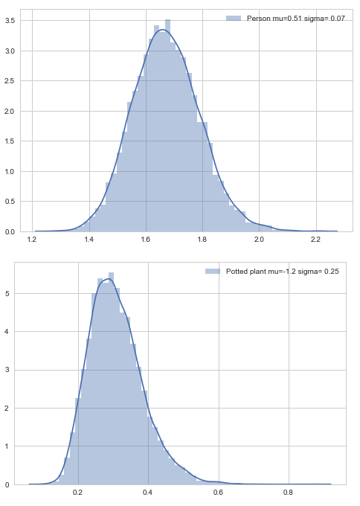
Bubble diameters (2*radius)
Distance Estimation

Slide 43

Bubble diameters (2*radius)
Distance Estimation

Slide 44

Bubble diameters (2*radius)
Distance Estimation

Slide 45





Radius of enclosing circle will be used for pattern
Distance Estimation
w
α
r
h
From bounding box coordinates to radius:
$$r=\sqrt{{(\frac{w}{2})}^{2}+{(\frac{h}{2})}^{2}}$$
$$h=(ymax−ymin)$$
$cy=(ymax+ymin)$/2
$$w=(xmax−xmin)$$
$$cx=(xmax+xmin)/2$$

Slide 46


Distance estimation using pattern circle and body sphere
Distance Estimation
$$d=\frac{f∗r}{\cos\left(α\right)∗\cos\left(\text{β}\right)∗r\text{i}∗\text{s}\text{h}\text{/}\text{p}\text{h}}$$
s_{h}$=sensor height \left(m\right)$
p_{h}= image height (pixels)
r_{i} = pattern radius (pixels)
r = body radius (m), mean from class specific distribution
f = focal length (m)
$α$ = altitude (rad)
β = azimuth (rad)

Slide 47
Distance Estimation
Remarks:
Video metadata often lacks sensor and focal parameters
Focal length can change during shooting (zooming)

Slide 48





x_{b},y_{b},z_{b} = body center point
3D Projection
y
x_{p},y_{p},z_{p} = pattern center point
x
z
From pixel coordinates x_{p}, y_{p} (sensor plane) to 3d camera coordinates:
s_{w}$=sensor width \left(m\right)$
s_{h}$=sensor height \left(m\right)$
p_{w}= image width (pixels)
p_{h}= image height (pixels)
h_{i} = object height (pixels)
h = object height (m)
f = focal length (m)
$α$ = altitude (rad)
(x_{p}, y_{p}, z_{p}) = (- $\frac{s_{w}}{2}+xp$* $\frac{s_{w}}{pw}$, $\frac{s_{h}}{2}−yp$* $\frac{s_{h}}{ph}$, -f)
Body center will be on the line:
(x_{b}, y_{b}, z_{b}) = t* (x_{p}, y_{p}, z_{p})
The distance to the body is:
$$d=\frac{f∗h}{\cos\left(α\right)∗\cos\left(\text{β}\right)∗\text{h}\text{i}∗\text{s}\text{h}\text{/}\text{p}\text{h}}$$
$α=$ arc tan(y_{p}/f)
$β=$ arc tan(x_{p}/f)

Slide 49





So:
$$t^{2}∗({x_{p}}^{2}+{y_{p}}^{2}{{+z}_{p}}^{2})=d^{2}$$
3D Projection
$$t=\frac{d}{\sqrt{{x_{p}}^{2}+{y_{p}}^{2}{{+z}_{p}}^{2}}}$$
Solving for t:
(x_{b}, y_{b}, z_{b}) = t* (x_{p}, y_{p}, z_{p})
Where:
(x_{p}, y_{p}, z_{p}) = (- $\frac{s_{w}}{2}+xp$* $\frac{s_{w}}{pw}$, $\frac{s_{h}}{2}−yp$* $\frac{s_{h}}{ph}$, -f)
$$t=\frac{d}{\sqrt{{x_{p}}^{2}+{y_{p}}^{2}{{+z}_{p}}^{2}}}$$
$$d=\frac{f∗h}{\cos\left(α\right)∗\cos\left(\text{β}\right)∗\text{h}\text{i}∗\text{s}\text{h}\text{/}\text{p}\text{h}}$$

Slide 50








Example:
s_{w}$=sensor width \left(m\right)$ = 0.0359 m
s_{h}$=sensor height \left(m\right)=0.0240 m$
p_{w}= image width (pixels) = 7360
p_{h}= image height (pixels) = 4912
r_{i} = pattern radius (pixels) = 100
r = body radius (m) = 1.0 m
f = focal length (m) = 0.050 m
x_{p} = 1200
y_{p} = 2000
3D Projection
(x_{p}, y_{p}, z_{p}) = (- $\frac{s_{w}}{2}+xp$* $\frac{s_{w}}{pw}$, $\frac{s_{h}}{2}−yp$* $\frac{s_{h}}{ph}$, -f)
= (- $\frac{0.0359}{2}+1200$* $\frac{0.0359}{7360}$, $\frac{0.0240}{2}−yp$* $\frac{0.0240}{4912}$, -0.050)
= (-0.0121, 0.0022, -0.0500)
$α=$ arc tan(y_{p}/f) = 0.0445
$β=$ arc tan(x_{p}/f) = -0.2374
$$d=\frac{f∗h}{\cos\left(α\right)∗\cos\left(\text{β}\right)∗\text{h}\text{i}∗\text{s}\text{h}\text{/}\text{p}\text{h}}$$
$=\frac{0.050∗1}{\cos\left(\text{0.0445}\right)∗\cos\left(\text{−0.2374}\right)∗\text{100}∗\text{0.0240}\text{/4912}}$ = 105.39
$t=\frac{\text{105.39}}{\sqrt{{\text{−0.0121}}^{2}+{\text{0.0022}}^{2}+{\text{−0.0500}}^{2}}}$ = 2.0468e+03
(x_{b}, y_{b}, z_{b}) = t* (x_{p}, y_{p}, z_{p})
= 2.0468e+03 * (-0.0121, 0.0022, -0.0500)
= (-24.7593, 4.5602, -102.3389)

Slide 51
Body Filtering
General
Enables prediction, including collision detection
Second order model does not work, constant acceleration makes bodies bounce back or get enormous velocities
In world, constant acceleration for several (tens) of seconds is not common
First order model works! (No wonder it’s popular in robotics…)
When measurement is lost, the body is switched into constant velocity mode

Slide 52

Body Filtering

Slide 53

Body Filtering

Slide 54

Body Filtering

Slide 55
Example 1
Body Filtering

Slide 56




Body Filtering

Slide 57


Body Filtering

Slide 58

Example 2
Body Filtering

Slide 59




Body Filtering

Slide 60


Body Filtering

Slide 62



Representations for Interpretation
Representation: Video
Interpretation Generation
Object detection network
Representation: Pattern
…
Interpretation representations
I1
I2
I3
Location and velocity estimation
Language Generation
Representation: Body
Forecast
Representation: Time series

Slide 63

Example for interpretation representation: collision detection
Representations for Interpretation
Time series forecast for body locations
Interpretation Generation
(Symmetric) collision probability matrix
p_{nm} = probability that bodies n and m will collide

Slide 64




s_{i}
r_{i}
Collision Detection
d_{ij}
s_{j}
r_{j}
Collision C_{ij} if d_{ij} < r_{i} + r_{j}
Random variable
t: uniform distribution on [0, t_{end}]
Sampling:
Open question:
Too many dimensions?
More efficient sampling with MCMC / Metropolis-Hastings?

Slide 65

Simpler case: Collision with the observer
Collision Detection
y
S=[0,0,0,0,0,0]^{T} , deterministic, r = r[class person]
s
r_{c}
x
z
s
s_{i}
For each body i, a random vector r is sampled
and minimum distance to the observer calculated.
If the distance is less than r1+r, collision occurred. The proportion on collisions to
all cases is the probability estimate for the
body/observer collision.

Slide 66





Collision Detection
In our case:
x₁=P(0)
x₂=P(0)+V(0) (loc after one sec)
x₀=0
- ?
If t<=0, nearest point is P(0)

Slide 67


Example
Collision Detection

Slide 68




Example
Collision Detection

Slide 69



Example
Collision Detection

Slide 70


Example
Collision Detection
T=50.56 sec
P=0.000

Slide 71



Example
Collision Detection
T=51.00 sec
P=0.000

Slide 72



Example
Collision Detection
T=52.00 sec
P=0.003

Slide 73



Example
Collision Detection
T=54.00 sec
P=0.019

Slide 74



Example
Collision Detection
T=56.00 sec
P=0.027

Slide 75



Example
Collision Detection
T=58.00 sec
P=0.019

Slide 76
Collision Detection
Open questions:
How to make uncertainty smaller?
Collision matrix reachable?

Slide 77


Distance estimation using object radius:
Collision Detection
$$t=\frac{d}{\sqrt{{x_{c}}^{2}+{y_{c}}^{2}{{+z}_{c}}^{2}}}$$
(x_{c}, y_{c}, z_{c}) = (- $\frac{s_{w}}{2}+xp$* $\frac{s_{w}}{pw}$, $\frac{s_{h}}{2}−yp$* $\frac{s_{h}}{ph}$, -f)
(x_{o}, y_{o}, z_{o}) = t* (x_{c}, y_{c}, z_{c})

Slide 78



Path chosen - a simpler solution which provides a lot more information
Prediction
Update is done n times
A
μ
∆ has to be smaller than 1/fps. If fps=25, 1/fps = 0.04 sec. A car driving 120 km/h will proceed
1.33 meters and a collision with an observer might not be detected well enough. A value of ∆ = 0.01 corresponds to the movement of 33 cm for an object moving at 120 km/h. This will generate 100 predictions per second. If we want the prediction horizon to be 10 secs, we have
1000 predictions per object. Predicting for every frame will generate fps*1000 ≈ 25 000 predictions per second per object. This is too much, so only current prediction is saved.

Slide 79

Prediction

Slide 80



Collision with the observer
Collision Detection
d₁
P(t’) = nearest point on the predicted trajectory
d
O
d_{o}
$$x\left(t\right)=x\left(0\right)+v_{x}\left(0\right)∗t$$
$$y\left(t\right)=y\left(0\right)+v_{y}\left(0\right)∗t$$
$$z\left(t\right)=z\left(0\right)+v_{z}\left(0\right)∗t$$
$$d^{2}\left(t\right)={x(t)}^{2}+{y(t)}^{2}+{z(t)}^{2}$$
$$d^{2}={(x\left(0\right)+v_{x}\left(0\right)∗t )}^{2}+{(y\left(0\right)+v_{y}\left(0\right)∗t )}^{2}+{(z\left(0\right)+v_{z}\left(0\right)∗t)}^{2}$$
$\frac{d({d(t)}^{2})}{dt}=2∗\left(x\left(0\right)+v_{x}\left(0\right)∗t \right)∗v_{x}\left(0\right)+$ $2∗\left(y\left(0\right)+v_{y}\left(0\right)∗t \right)∗v_{y}\left(0\right)+$ $2∗\left(z\left(0\right)+v_{z}\left(0\right)∗t \right)∗v_{z}\left(0\right)=0$
$t^{′}=$ $−\frac{x\left(0\right)∗v_{x}\left(0\right)+y\left(0\right)∗v_{y}\left(0\right)+z\left(0\right)∗v_{z}\left(0\right)}{{v_{x}\left(0\right)}^{2}+{v_{y}\left(0\right)}^{2}+{v_{z}\left(0\right)}^{2}}$

Slide 81
Work in Progress

Slide 82
Perception
“The first step in achieving SA is to perceive the status, attributes, and dynamics of relevant elements in the environment. Thus, Level 1 SA, the most basic level of SA, involves the processes of monitoring, cue detection, and simple recognition, which lead to an awareness of multiple situational elements (objects, events, people, systems, environmental factors) and their current states (locations, conditions, modes, actions).”

Slide 83
Next Steps

Slide 84
Next steps
Kalman filter parameter adjustment
Experiments in wild
Paper

Slide 85

Experiment 1 in the wild (locations)
Experiment In Wild
Different locations and heights
Nikon D800E:
s_{w}$=sensor width \left(m\right)$ = 0.0359 m
s_{h}$=sensor height \left(m\right)=0.0240 m$
p_{w}= image width (pixels) = 7360
p_{h}= image height (pixels) = 4912
h = object height (m) = 1.5 m
f = focal length (m) = 0.020 m
fov = $2∗atan⁡(\frac{s_{w}}{2∗f})$ = 83.81 ⁰

Slide 86

Experiment 2 in the wild (moving car)
Experiment In Wild
Car speeds:
0
20 km/h
40 km/h
60 km/h
80 km/h
Distances:
10 m
20 m
30 m
40 m
50 m
60 m
70 m
80 m
90 m
100 m
Nikon D800E:
s_{w}$=sensor width \left(m\right)$ = 0.0359 m
s_{h}$=sensor height \left(m\right)=0.0240 m$
p_{w}= image width (pixels) = 7360
p_{h}= image height (pixels) = 4912
h = object height (m) = 1.5 m
f = focal length (m) = 0.050 m
fov = $2∗atan⁡(\frac{s_{w}}{2∗f})$ = 39.49 ⁰

Slide 87
Image-based situation awareness: Estimating location and velocity using single camera object detection
Paper
?????
Contents:
Abstract
Introduction
Related work
Our approach
Definitions
Object identity
Distance estimation
Location and velocity estimation
Movement prediction
Experiments
Test setup
Evaluation metric
Results
Other experiments
Conclusion
detection, pattern…
Hungarian algorithm, distance metrics,
movement prediction
geometry
Kalman filtering
Difference equation, uncertanties
In the wild. See previous slides. More?
Existing datasets? Which?

Slide 88
One solution for location estimation and movement prediction for video detected object (nearly) solved
Work needed:
Kalman filter parameter adjustment*
Experiments in the wild (see previous slides)
Other tests? (using existing (tracking) dataset)
Where to publish?
ECCV 2018 (8-14.9, Munich, deadline 14.3.2018, too soon)
CVPR 2019 (6/2019, Long Beach, deadline 11/2018)
ICCV 2019 (29.10.-3.11.2019, Seoul, deadline 1/2019)
Paper
*Locations and especially velocities take too much time to settle at the moment.

Slide 89
To Be Discussed

Slide 90
To Be Discussed
Activity recognition?
Emotion recognition?
Turning camera, estimation by background movement?

Slide 91
Thank you!
lampola@student.tut.fi
https://github.com/SakariLampola/Thesis

